Slide 1
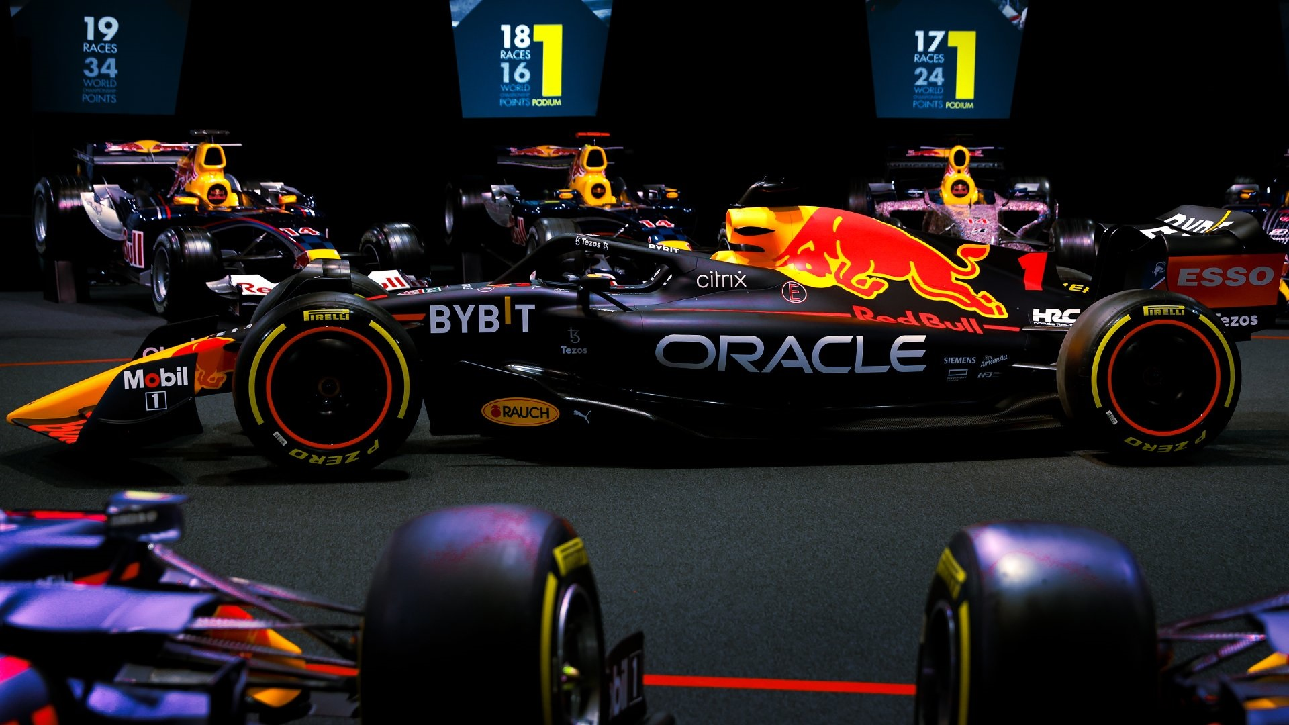
Team Road Ranger 5.0
Notes:
F1 working to solve wet-weather problem (grandprix.com)
<number>

Slide 2


Problem Scenario Fact
Weather conditions are correlated to racing events.
Climate change will exacerbate weather patterns thus impacting racing of F1 with more rain/storms etc. F1 needs to optimize a solution for weather prediction accuracy for wet weather race to maximize their earnings.

Slide 3
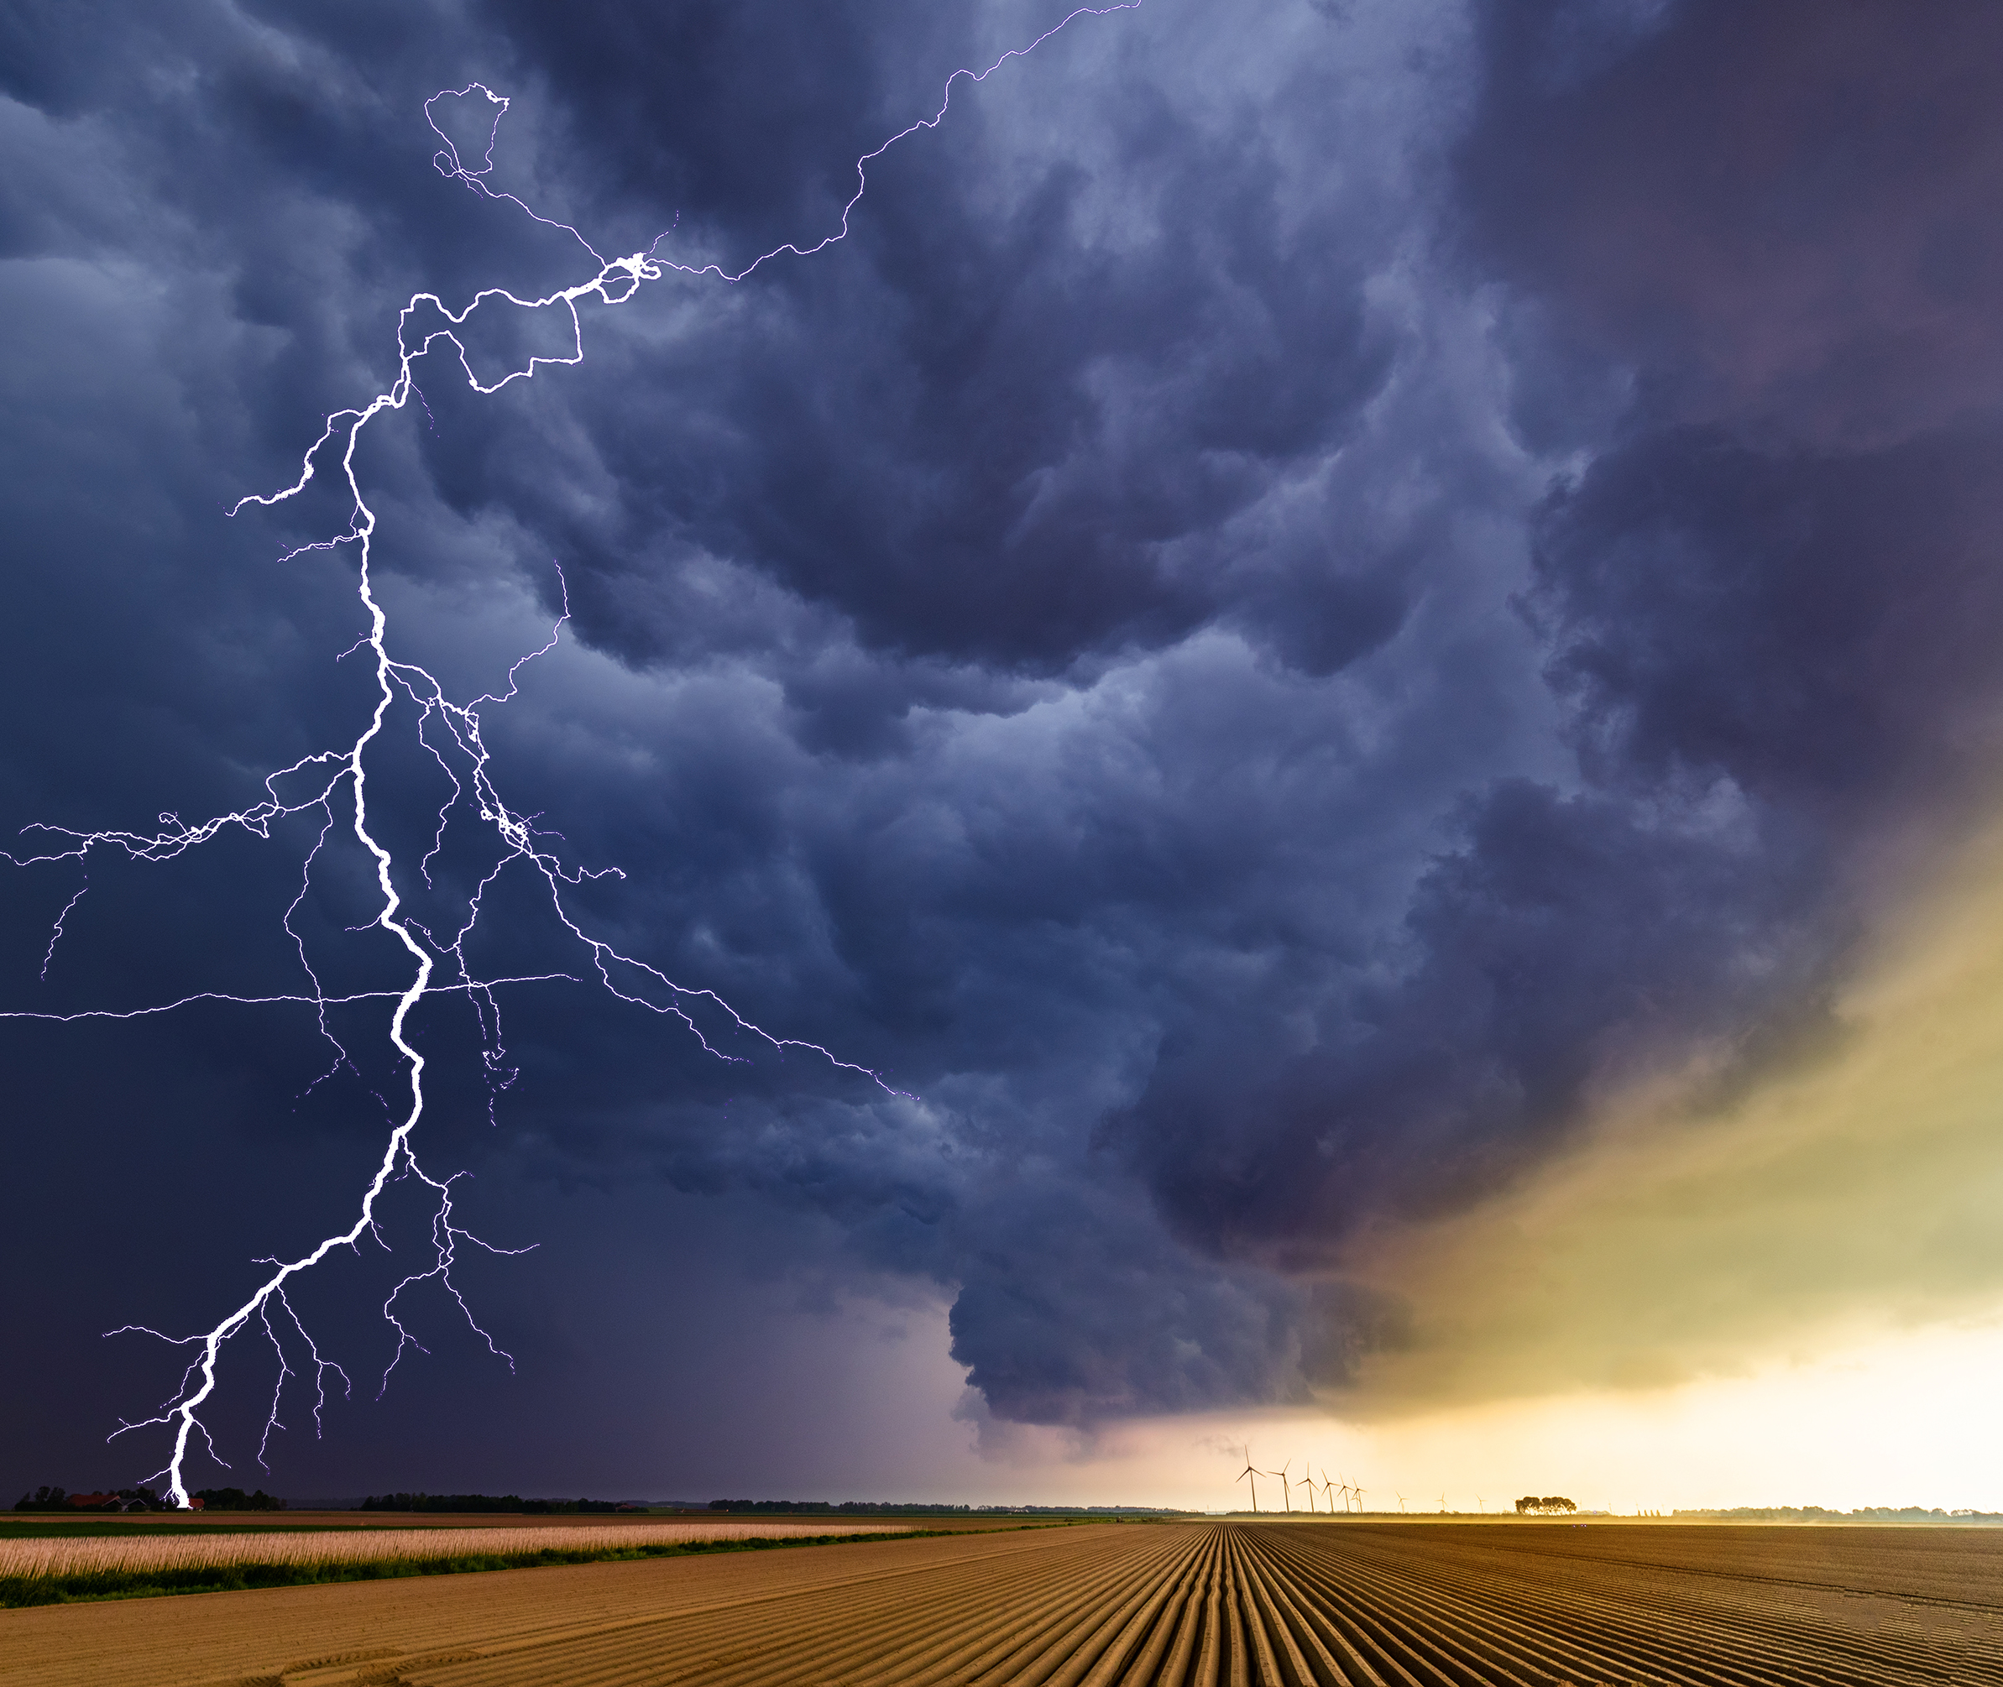
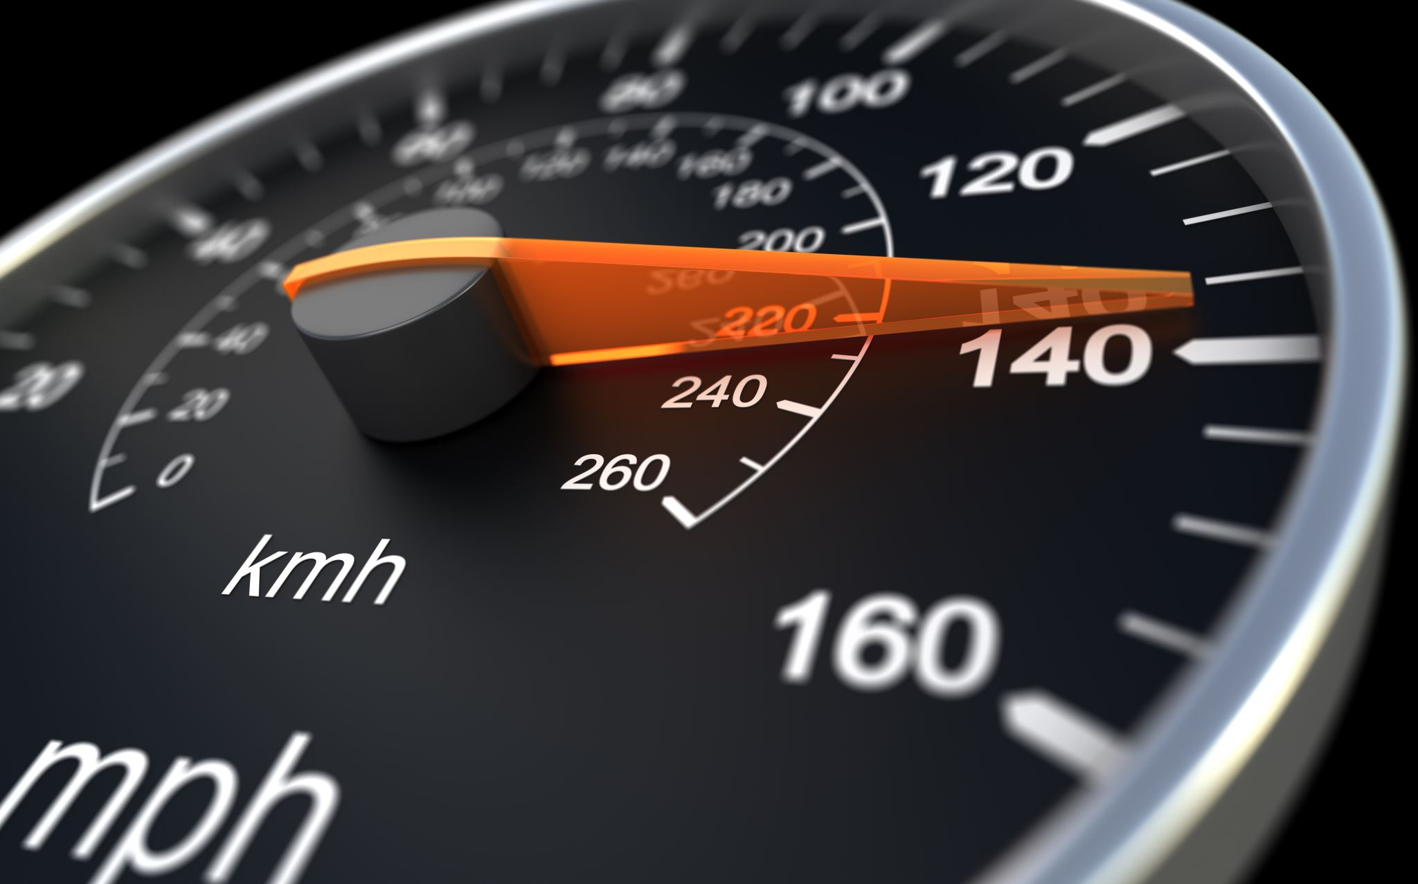

Road Ranger 5.0 Solution
Developed Artificial Intelligence model that is able to make accurate weather predictions / forecasts for RedBull Racing eSports team at 99% confidence level (accuracy)

Slide 4
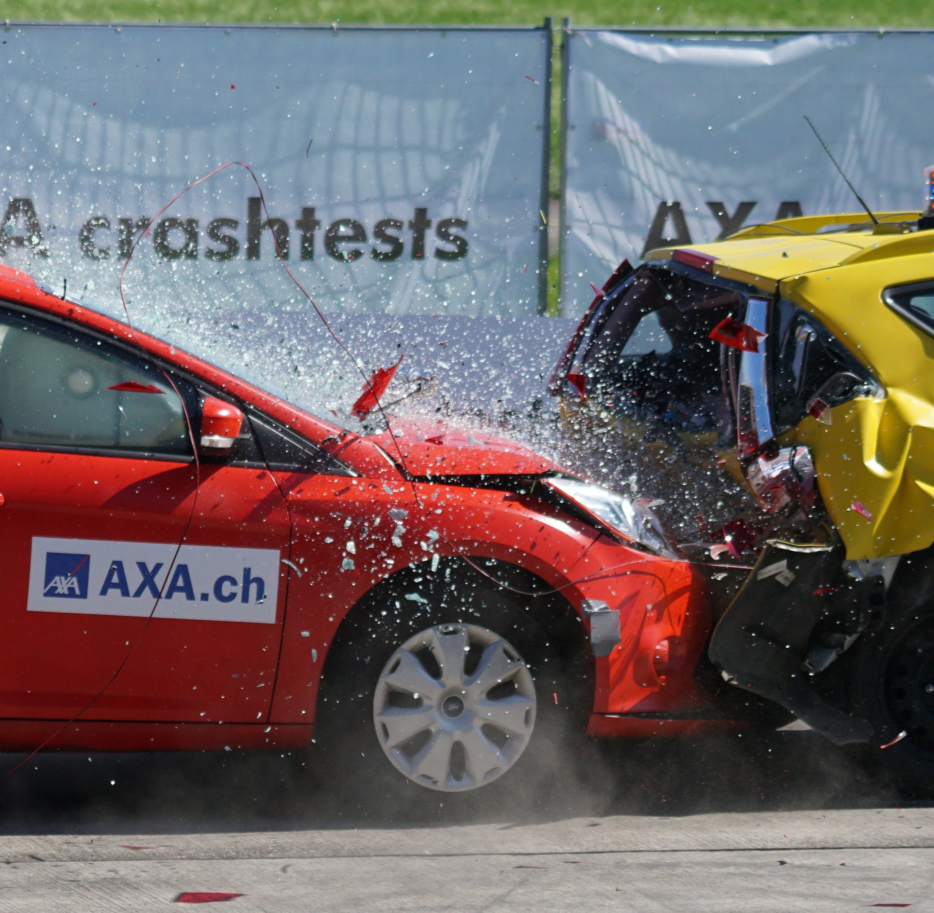
Road Ranger 5.0 AI Real World Application can save lives of people on the Roads by accurate prediction of weather.
Every year more than 1.35 million people die on the world’s roads and millions more injured. This preventable epidemic hits the poorest hardest and is killing the next generation. (www. brakes.org.uk)

Slide 5
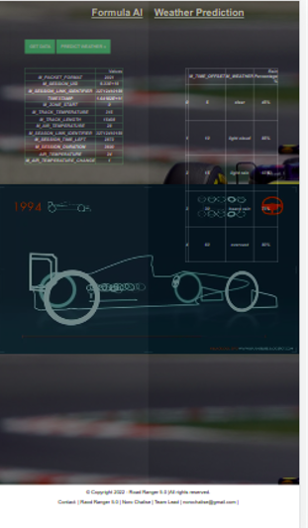
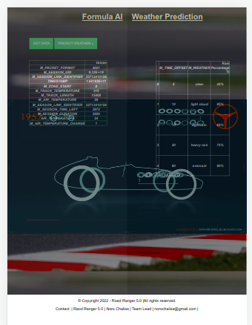
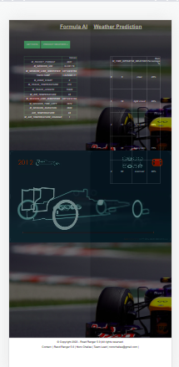
Solution: Application Road Ranger 5.0 IPAD and Website and IPhone User Interface

Slide 6
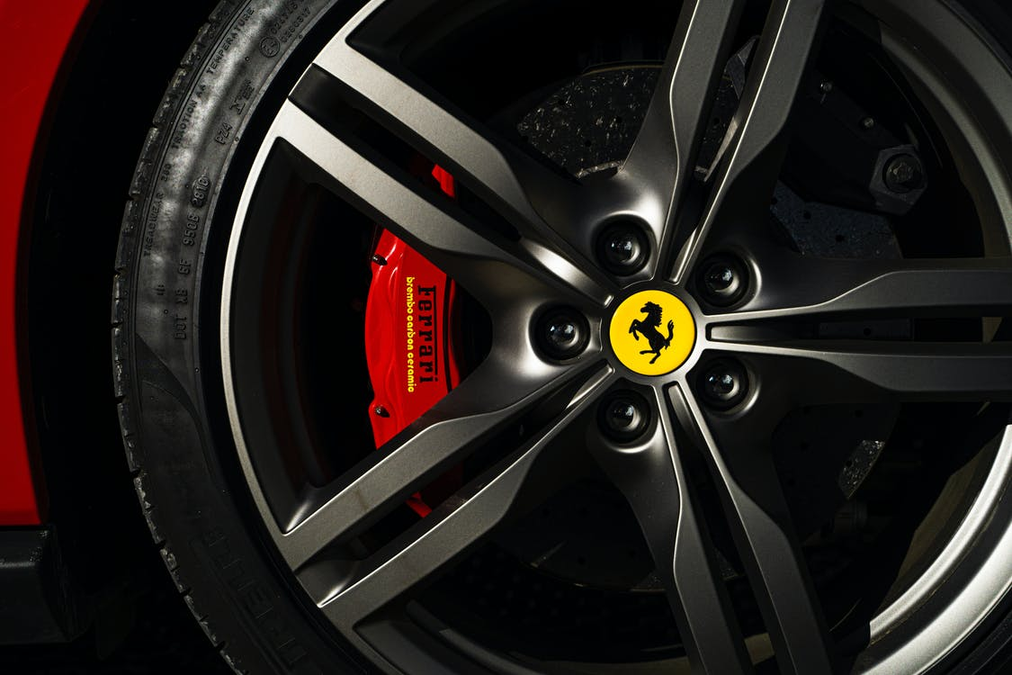

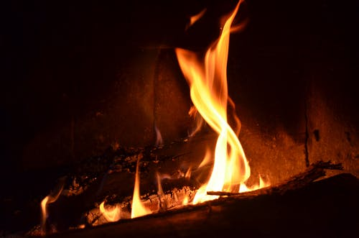
Variables for Model
There are three types of tyres allowed in F1: wet conditions with standing water on the track (wets), dry weather tyres (slicks), and intermediates (best for showery conditions.
Rain can lower brake temperatures, therefore affecting brake performance. If there is a lot of water on the track, a team may decide to raise the front of the car higher off the ground, which will slow the car down because the aerodynamics will be reduced, but it will keep the car above the level of the surface water, making it a bit easier for the driver to see
In hot weather, the temperature in the cockpit can easily climb above 50°C and the drivers need to be extremely fit to cope with dehydration. Fernando Alonso once lost 5 kilos in a race after his in-car water bottle broke, and he collapsed with dehydration after the race

Slide 7
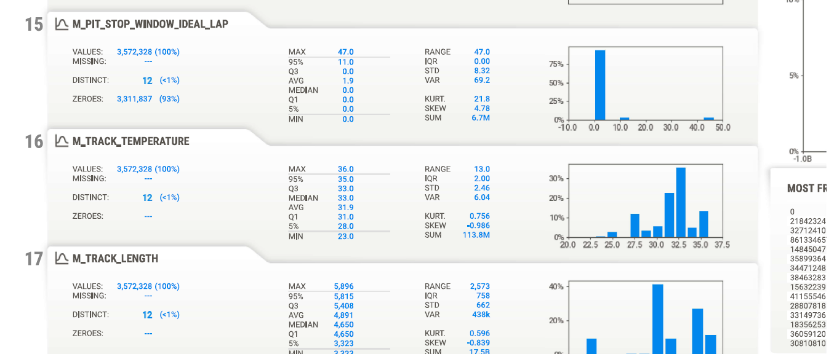
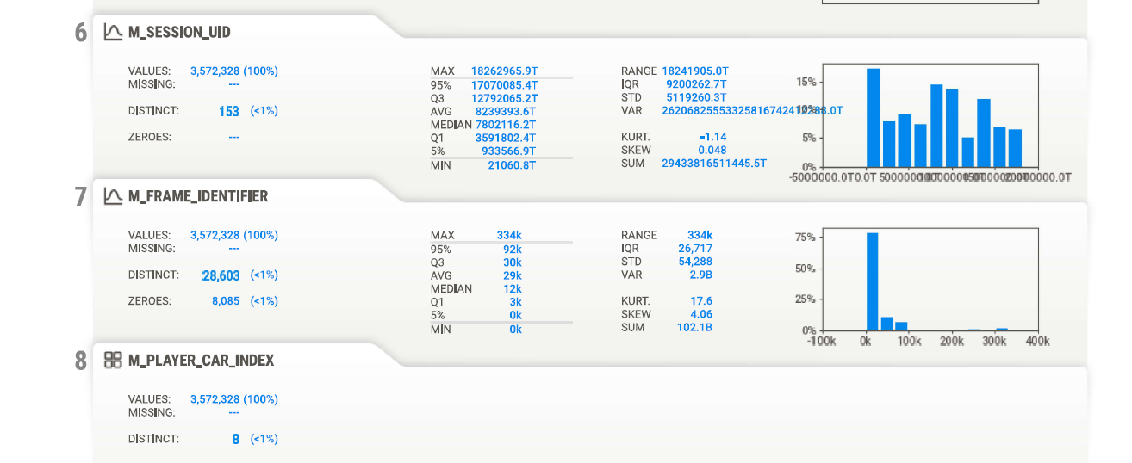

Exploratory Data Analysis

Slide 8











Technology Tools Used
Notes:
<number>

Slide 9


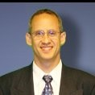





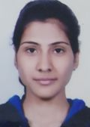

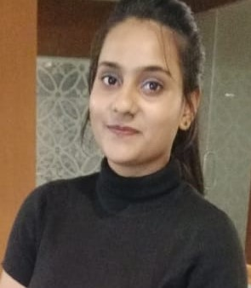

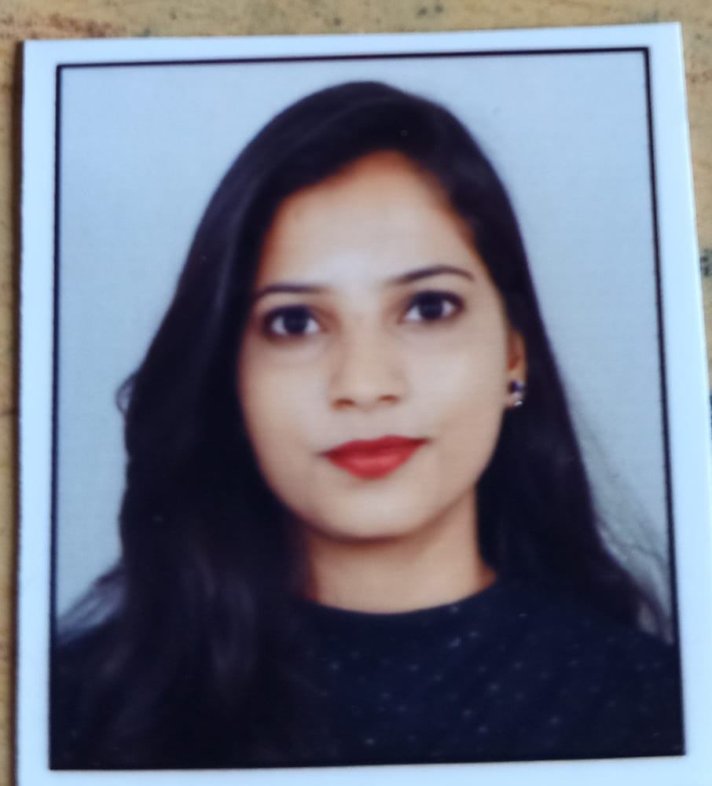

TEAM Road Ranger 5.0
Jason Lowe
Lead Mentor: Senior Developer
Brian Macdonald
Mentor: Data Scientist
Dr. Radika Kumar
Lead Mentor: Adviser Digital Infrastructure Policy/Economist
Noro Chalise
Project Team Lead
Ashwini Ghatode
AI and ML Developer
Anjali Gupta
Concept Developer
Shalini Kuchya
Data Analyst
Ashwani Kumar
Backend Developer
Aditi Agrawal
Front End Developer
Notes:
<number>

Slide 10

References and Datasets
https://github.com/jitusharma7/Exam-Mark
F1 and the weather | Royal Meteorological Society (rmets.org)

